Slide 1
HOTEL BOOKING status
PREDICTION
Group 10
Lan Dinh
Phoebe Amable
Aye Sandar Maung

Slide 2
DATASET
18
NO
36K
FEATURES
NULL VALUES | DUPLICATES
RECORDS
13 numeric, 3 categorical, 1 ID
overview

Slide 3
Feature | Type | Description
Booking_ID | Object | Unique identifier for each booking
no_of_adults | Int | Number of adults per reservation
no_of_children | Int | Number of children per reservation
no_of_weekend_nights | Int | Number of weekend nights booked
no_of_week_nights | Int | Number of weekday nights booked
type_of_meal_plan | Categorical | Type of meal plan selected
required_car_parking_space | Int | Whether parking is required (0/1)
room_type_reserved | Categorical | Type of room selected
lead_time | Int | Number of days before arrival the booking was made
arrival_date | Date | Date of arrival
market_segment_type | Categorical | Source of booking (Online, Corporate, etc.)
repeated_guest | Int | Whether the guest has stayed before (0/1)
no_of_previous_cancellations | Int | Previous cancellations by the customer
no_of_previous_bookings_not_canceled | Int | Previous successful bookings
avg_price_per_room | Float | Average price per night per room
no_of_special_requests | Int | Number of special requests made
booking_status | Categorical | Target variable — “Canceled” or “Not_Canceled”

Slide 4
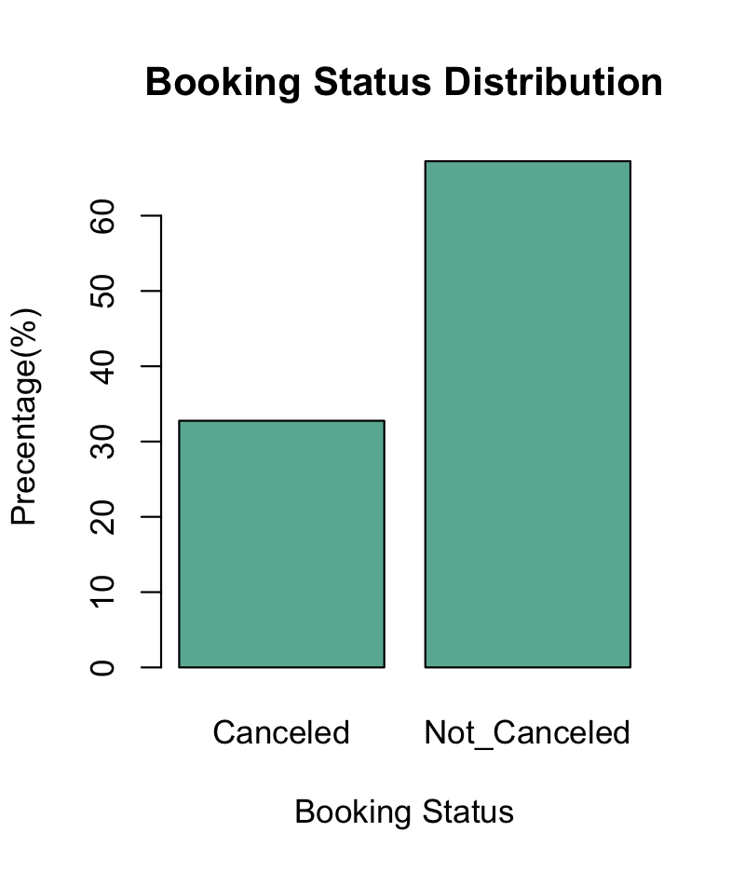
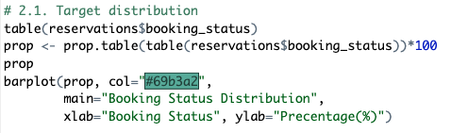
VISUALIZATIONS
(Target)

Slide 5
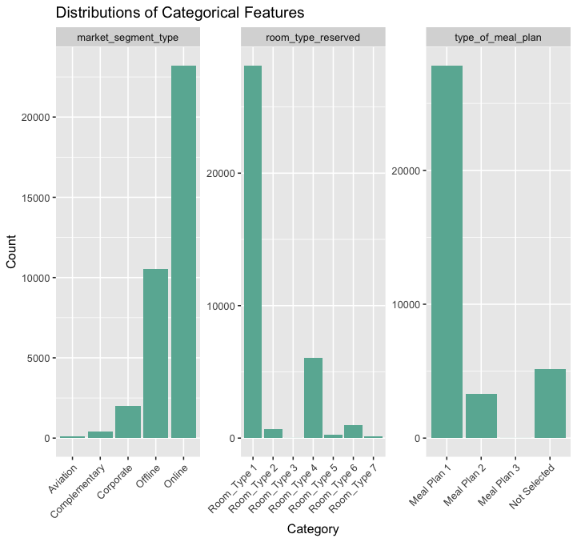
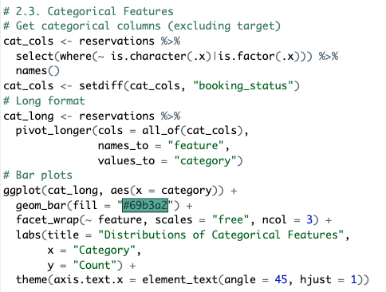
VISUALIZATIONS
(CATEGORICAL)

Slide 6
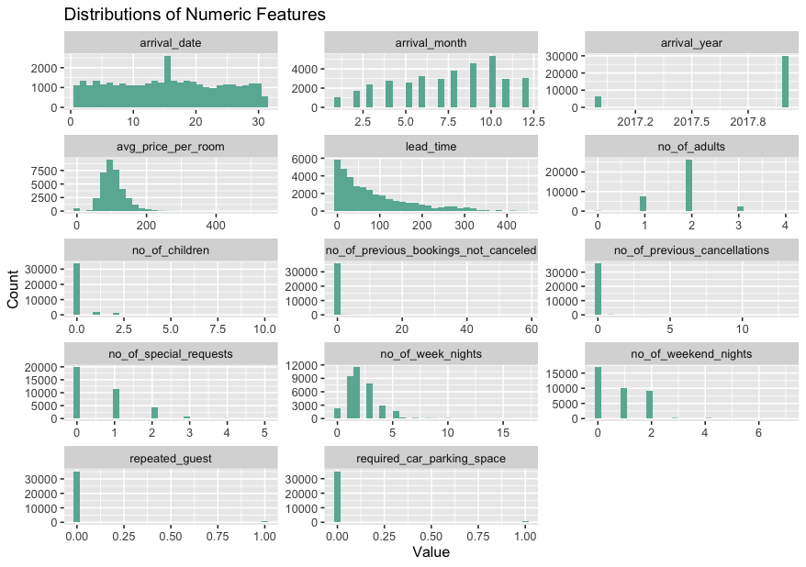
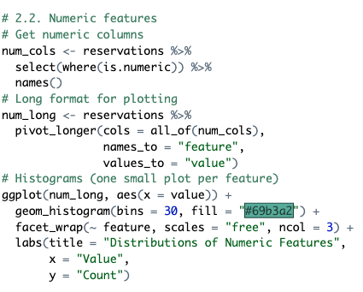
VISUALIZATIONS
(NUMERIC)

Slide 7
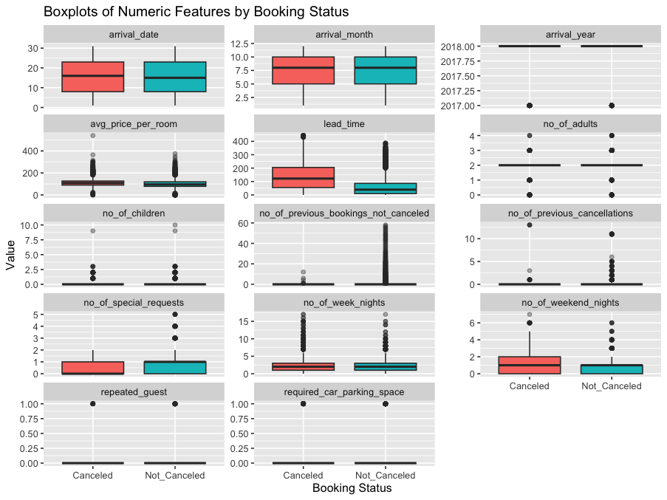
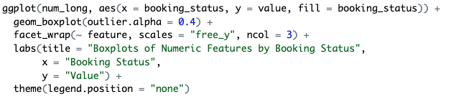
VISUALIZATIONS
(BOXPLOTS)

Slide 8
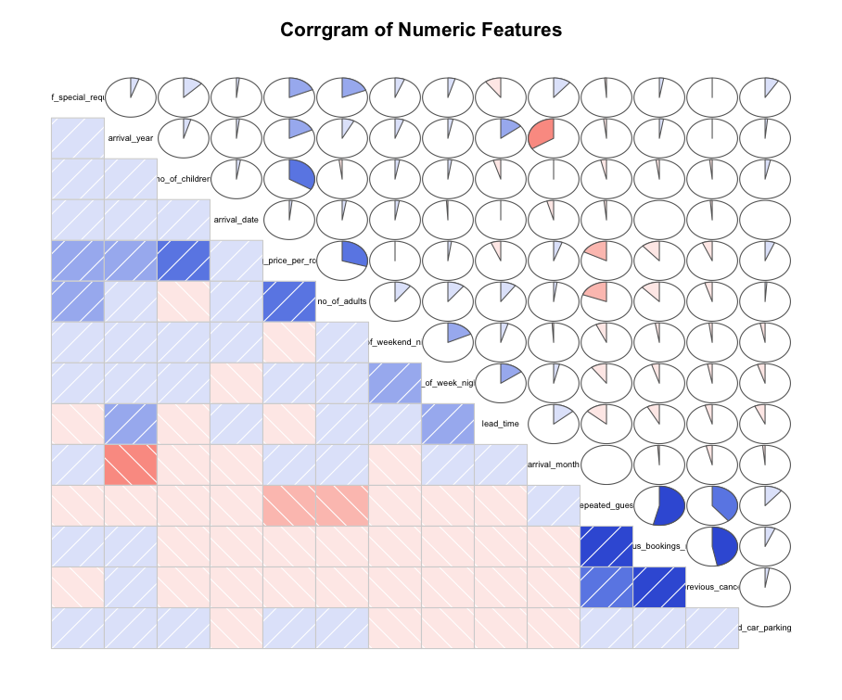
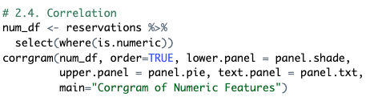
VISUALIZATIONS
(CORRGRAM)

Slide 9
MODEL
BUILDING

Slide 10
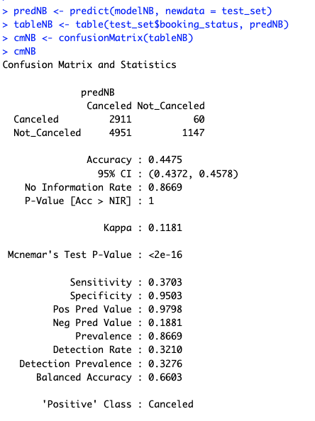
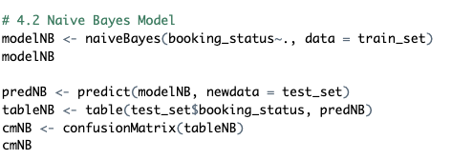
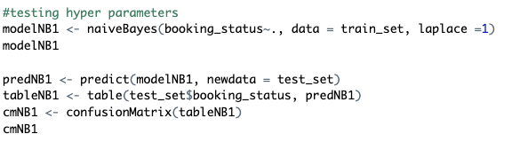
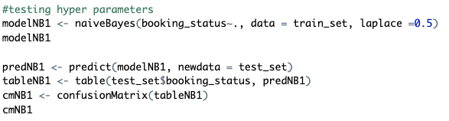
Naive Bayes
performed poorly

Slide 11
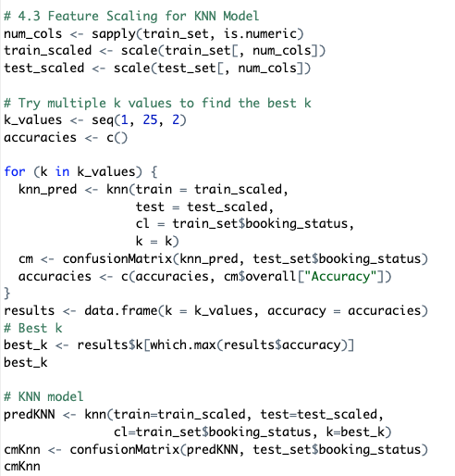
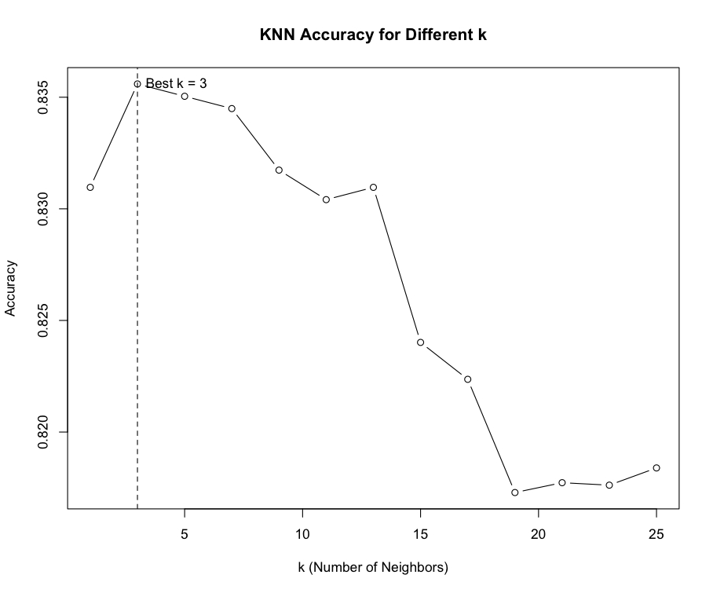
KNN

Slide 12
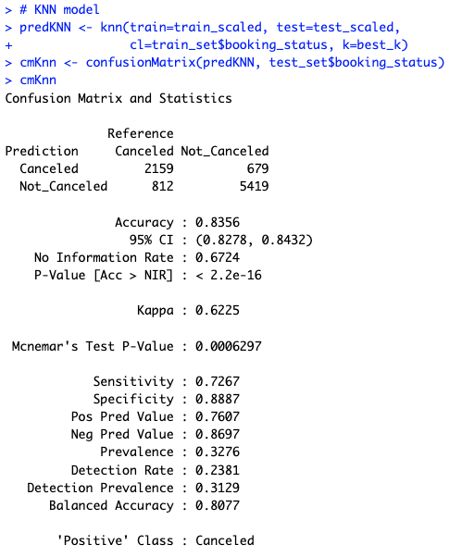
KNN

Slide 13
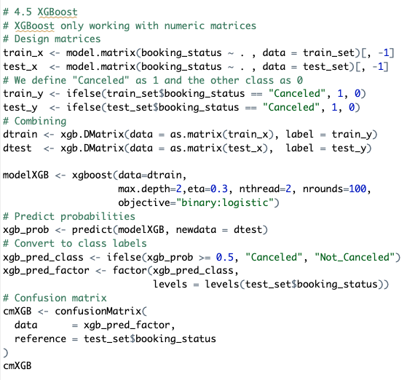
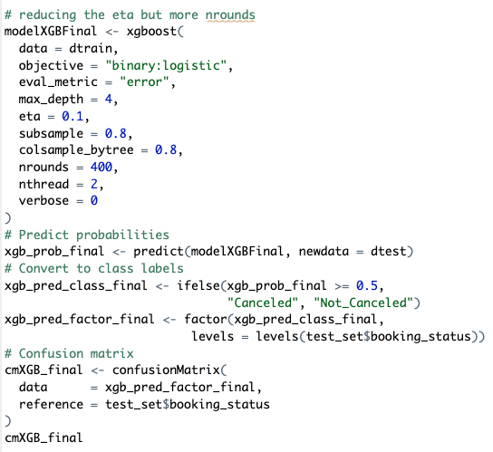
XGBoost

Slide 14
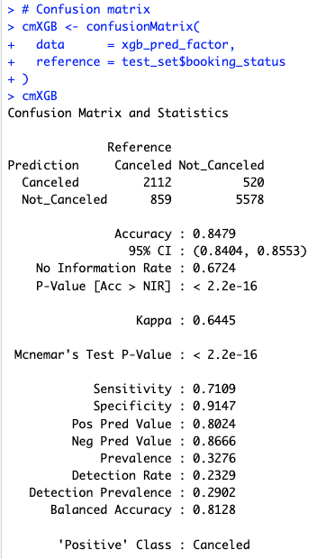
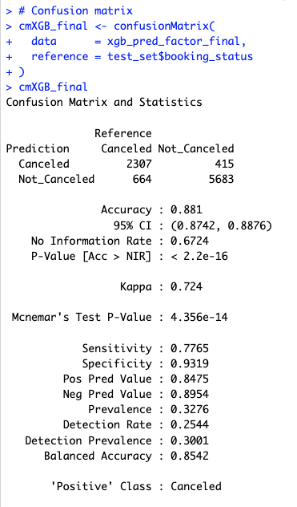
XGBoost
Decreasing eta
+ do more rounds
=> Better result

Slide 15
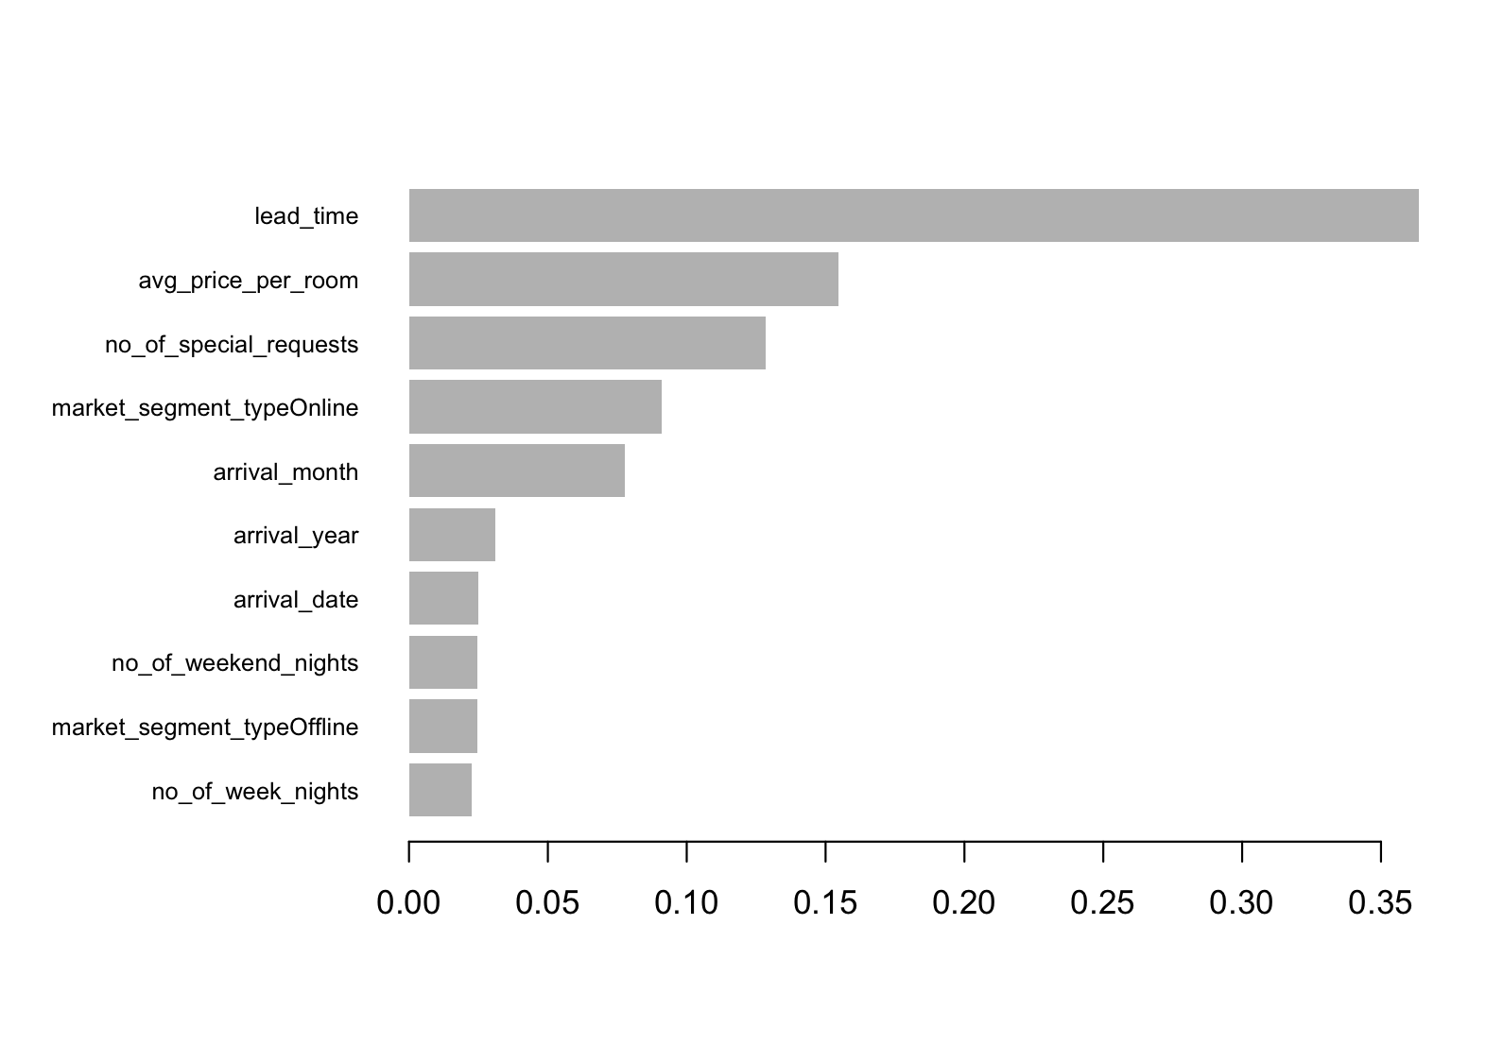
Feature importance with xgboost

Slide 16
SVM Model

Slide 17
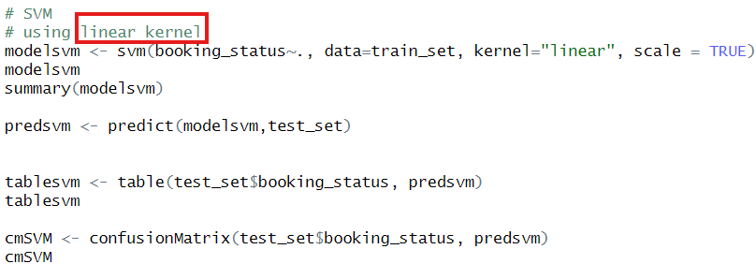
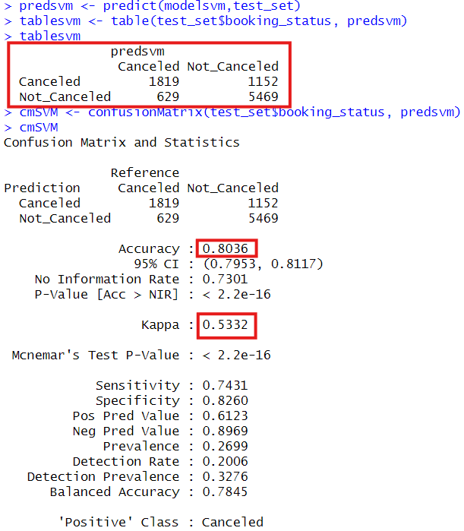
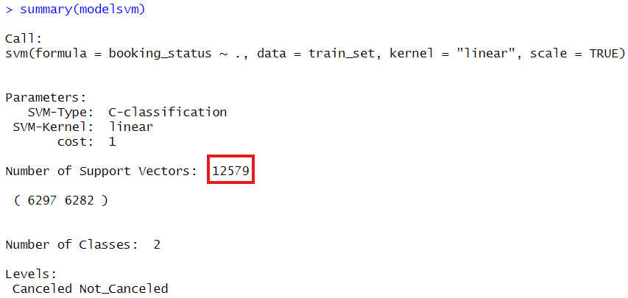

Slide 18
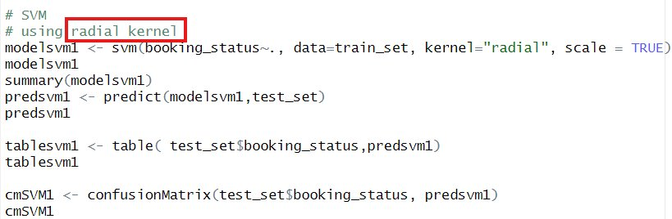
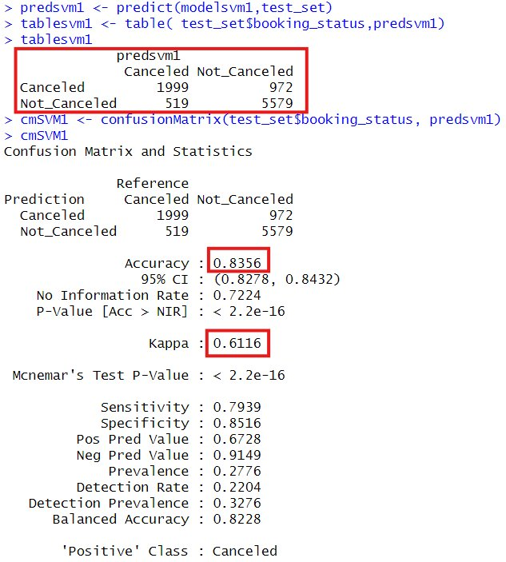
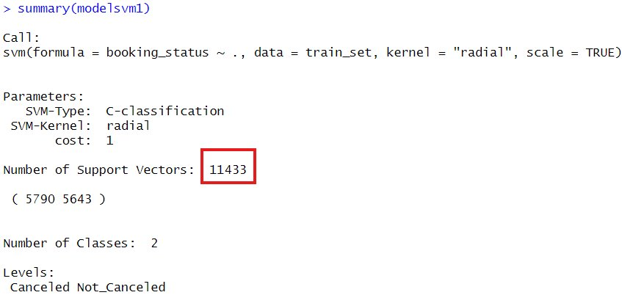

Slide 19
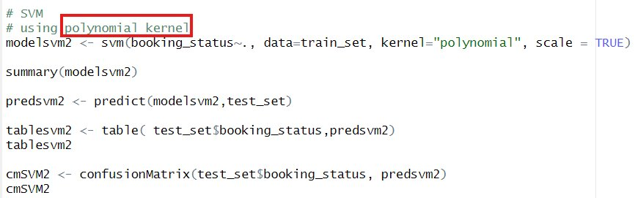
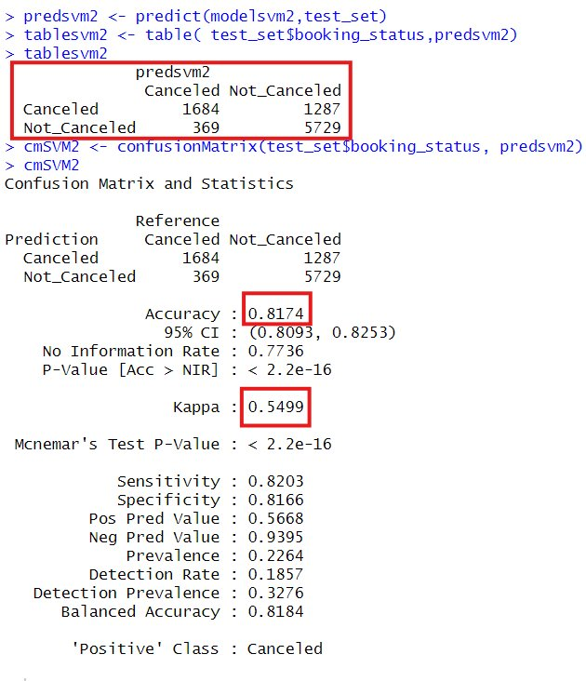
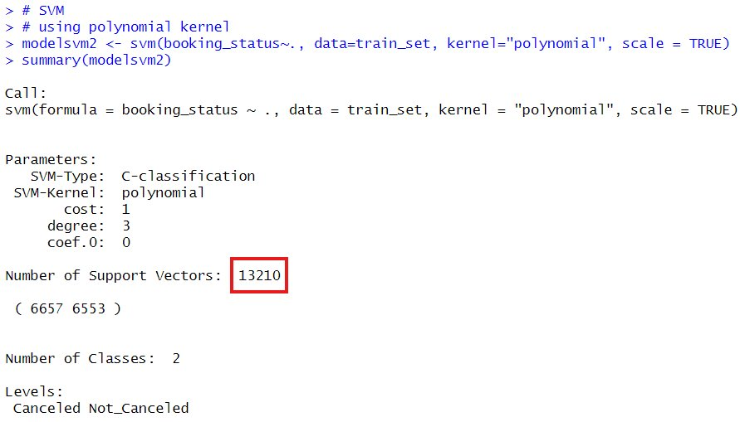

Slide 20
KSVM Model

Slide 21
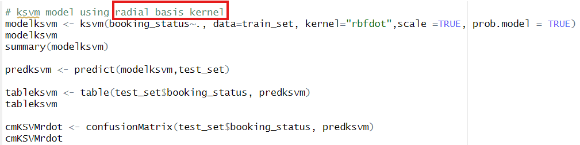
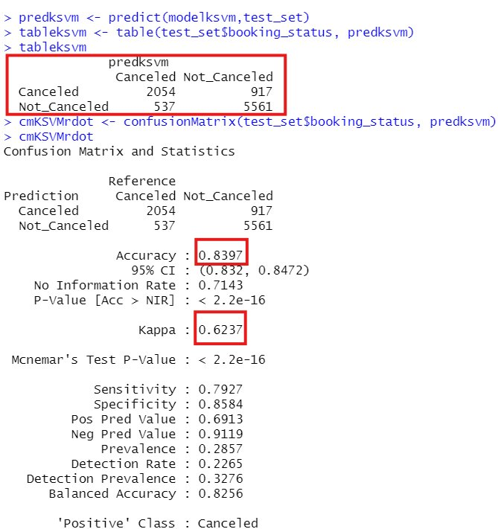
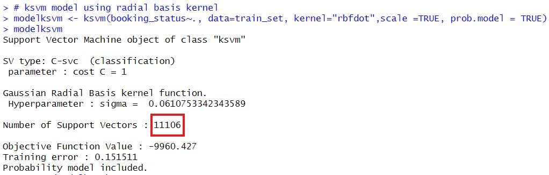

Slide 22
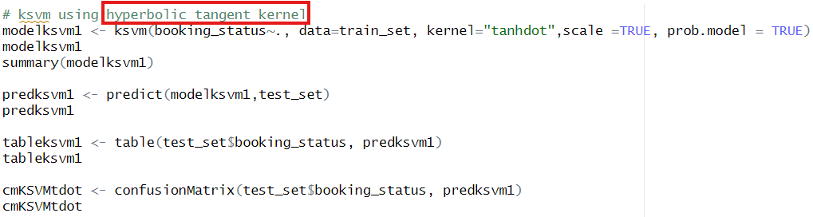
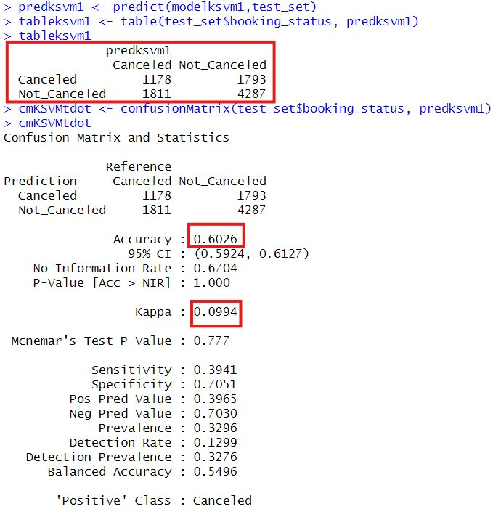
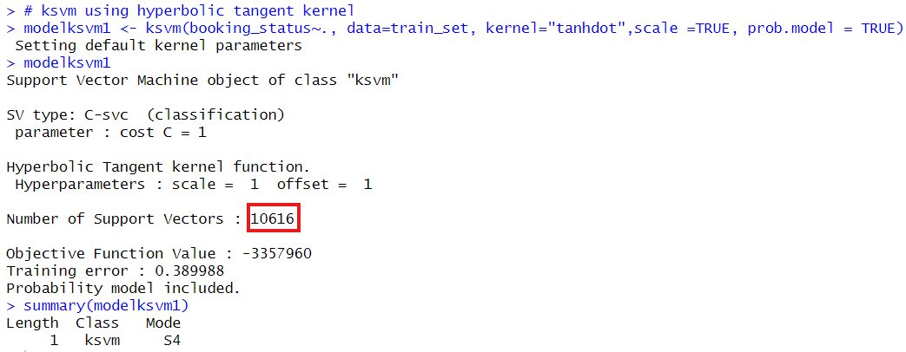

Slide 23
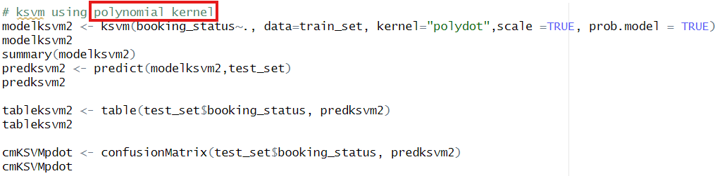
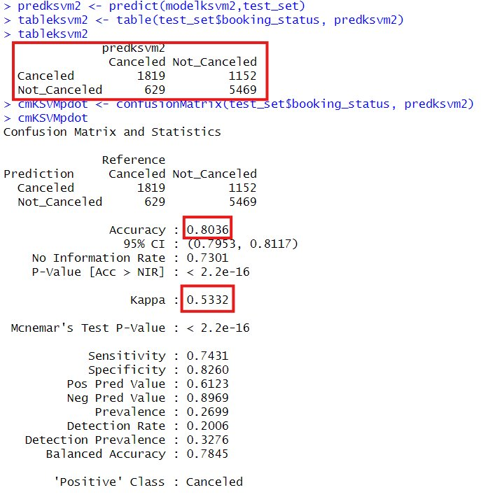
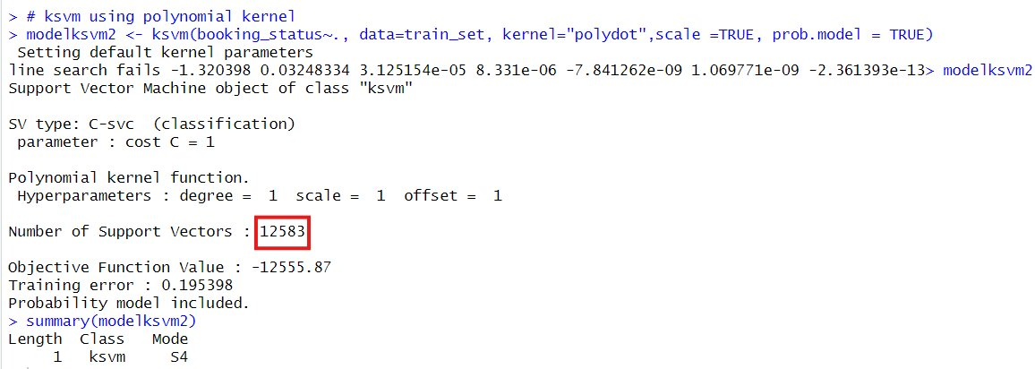

Slide 24
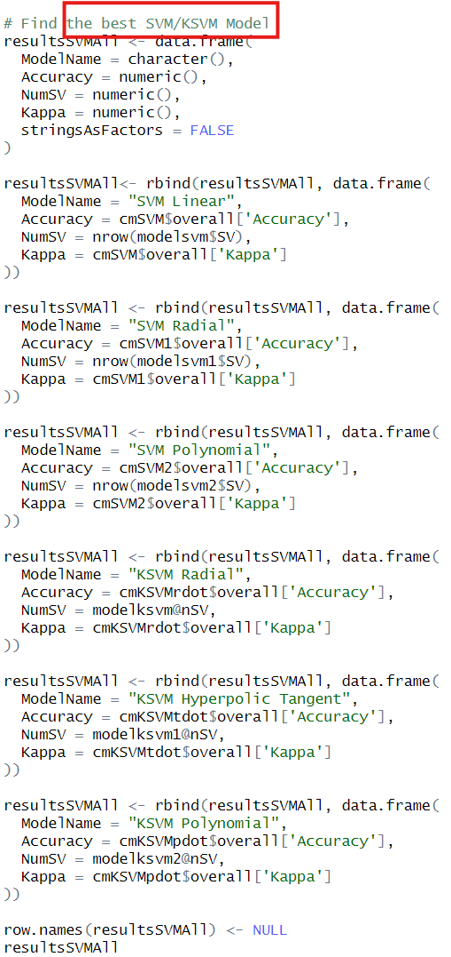
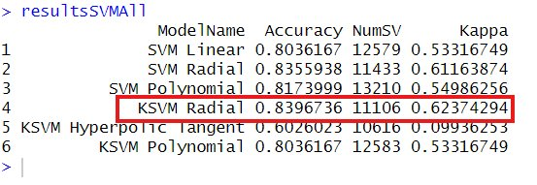
The best SVM/KSVM Model
KSVM Radial Basis Kernal
Accuracy
0.8396
Number of support vectors
1106
Kappa
0.6237

Slide 25
Random forest

Slide 26
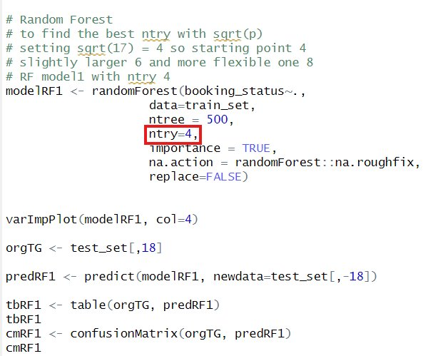
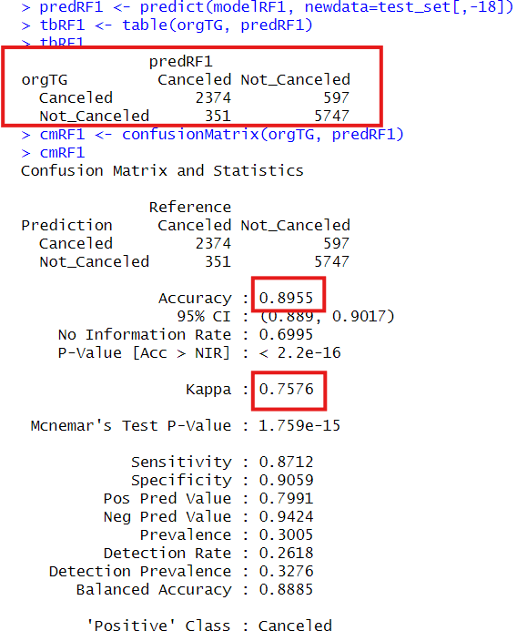
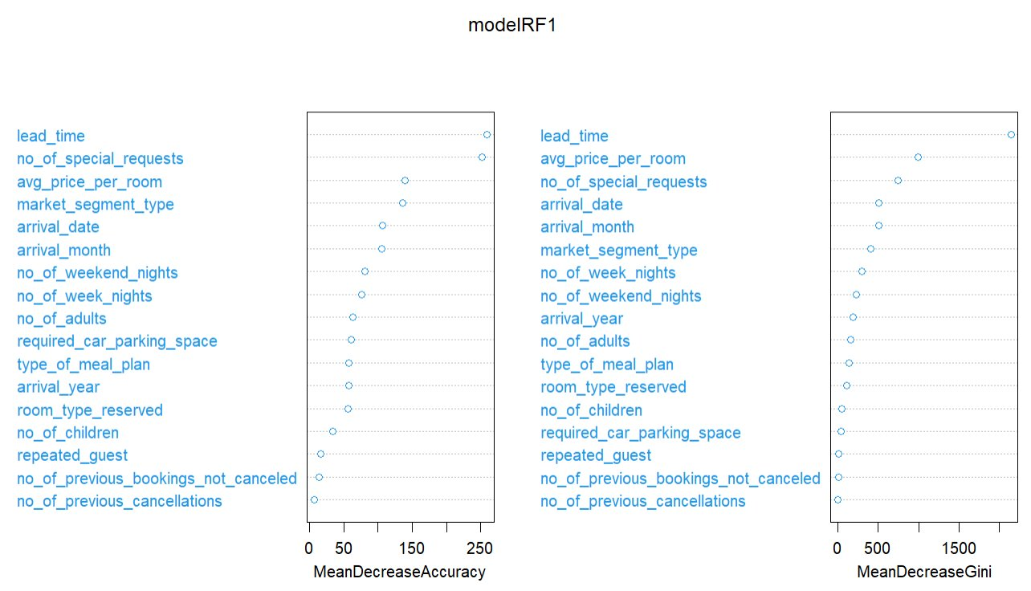

Slide 27
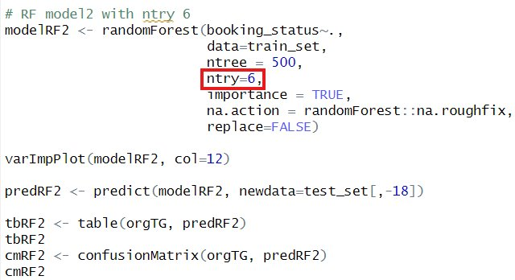
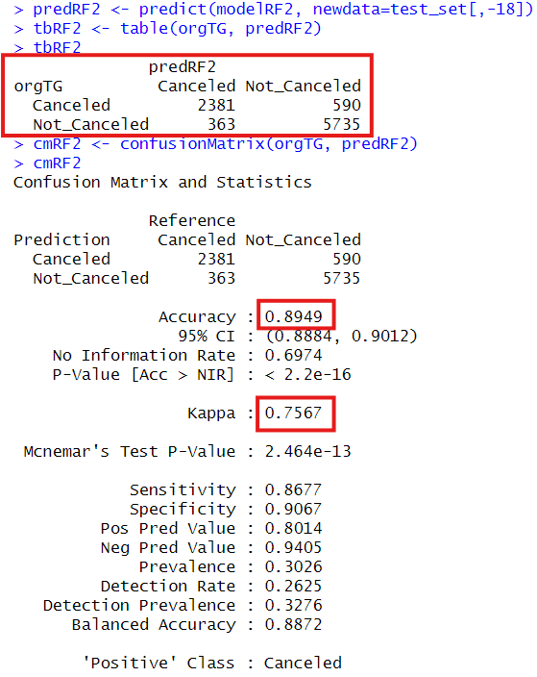
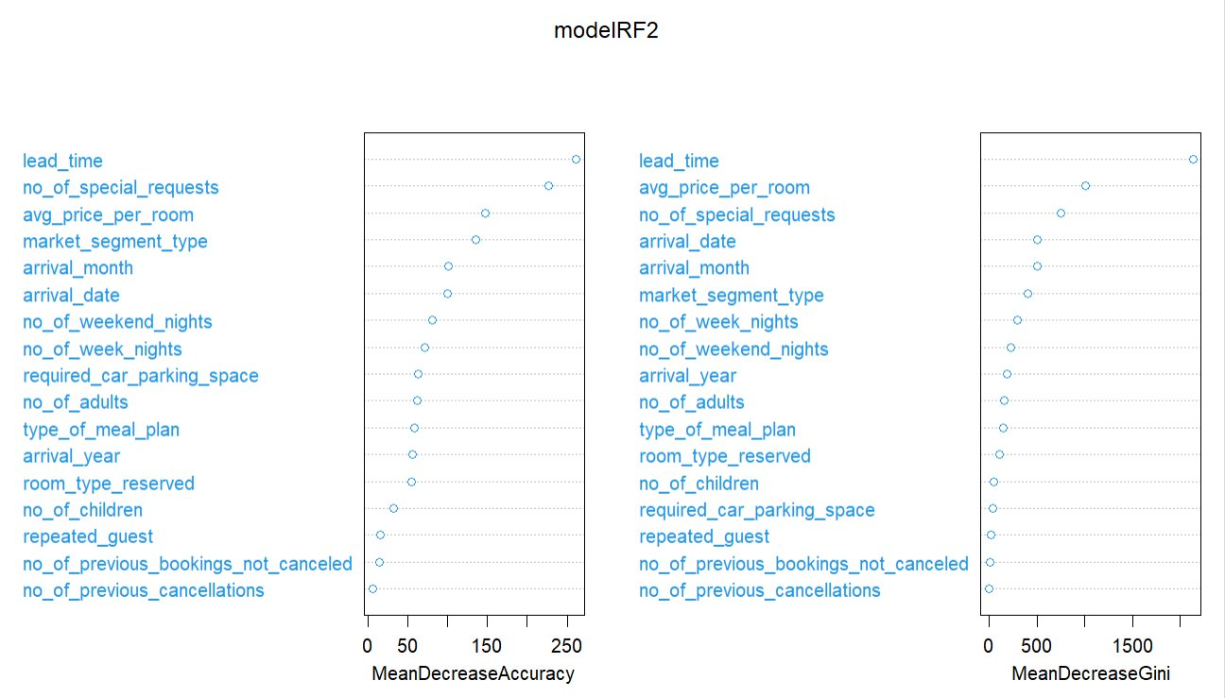

Slide 28
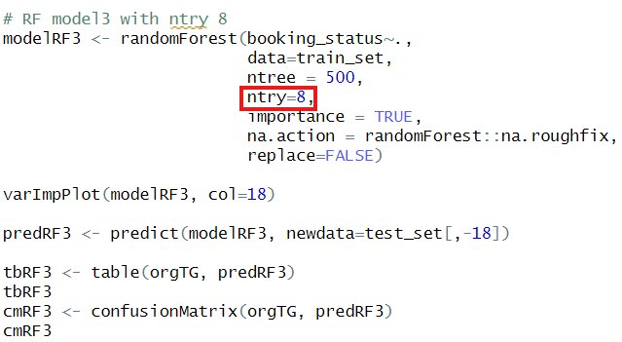
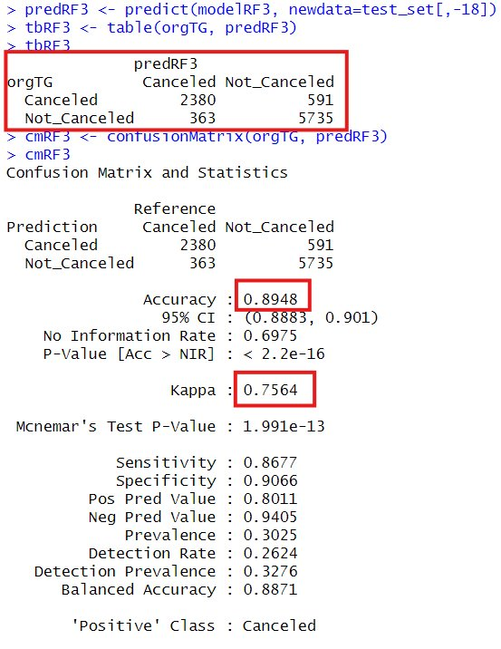


Slide 29


The best Random Forest Model
Parameter - ntry 4
Accuracy
0.8955
Kappa
0.7576
CE
0.1045

Slide 30
Decision Tree

Slide 31





Slide 32



Notes:
Cp = 0 means no pruning of the tree and allows the tree to grow however necessary.
Not good because overfitting

Slide 33




Notes:
Cp 1 was the opposite and was meaningless

Slide 34





Slide 35





Slide 36


The best Decision Tree Model
Parameters
Minsplit – 1000, Maxdepth -10
Accuracy
0.8236
Kappa
0.59
CE
0.1764
Notes:
Although it did not have the highest accuracy, it was the most reliable

Slide 37

Feature importance
Of
Decision Tree Model

Slide 38
Bagging

Slide 39




maxdepth
minsplit

Slide 40


Best
parameters
for
Bagging
model
maxdepth
20
minsplit
10
nbag
500

Slide 41


Accuracy
0.8936
Kappa
0.7528
Bagging model

Slide 42
Logistic Regression

Slide 43



Full Model
with all features

Slide 44


Reduced Model
excluded 3 Features

Slide 45



Anova Test
Confusion Matrix of
Full Model
Notes:
According to Kappa negative 0.4 and low accuracy 0.1958
Excluded Logistic Regression in Model comparison

Slide 46
Comparison
of
all models

Slide 47


Result Table for All Models

Slide 48


All models Accuracy Bar plot

Slide 49


All models F1 Score Bar plot

Slide 50


All models CE Bar plot

Slide 51



Slide 52
conclusion
Hotel Booking Status Classification
the best model is random forest
Accuray – 0.897
F1 – 0.836
Kappa – 0.761
CE – 0.103

